Slide 1
BENTON COUNTY
C-PACE PROGRAM
Presented by:
Andrea Novak | July 27, 2023

Slide 2
COMMERCIAL PROPERTY ASSESSED CLEAN ENERGY (C-PACE)
C-PACE has emerged as a valuable finance tool for both energy efficiency and renewable energy projects including retrofits and new construction. As with other finance options, borrowed capital is used to cover upfront cost but in this case, it is repaid gradually through a voluntary tax assessment. As the program administrator, the MinnPACE team facilitates tax assessments in accordance with state legislation and a joint powers agreement with Benton County.
According to the U.S. Department of Energy, C-PACE is one of the fastest growing finance structures in the United States.
36 states + and the District of Columbia have passed C-PACE legislation
Since 2009, there have been more than 2,000 C-PACE projects across the united States ($1.9 billion)
Minnesota continues to be a C-PACE leader through early adoption and rapid growth statewide

Slide 3
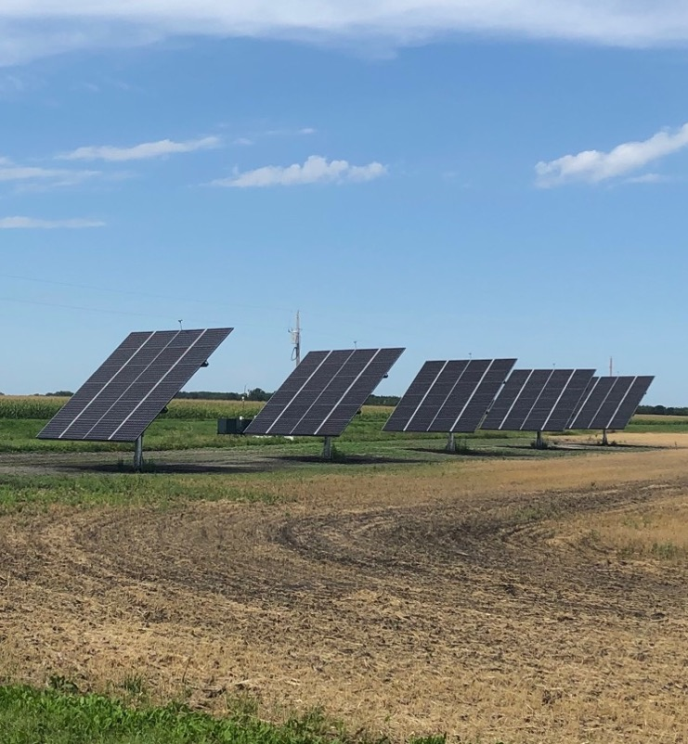
CASH POSITIVE BENEFITS
100 Percent Financing
Fixed Rate + Extended Term
Lower Energy Usage
Lower Utility Costs
No Payment Until May the Following Year

Slide 4
where to start
We believe that a great place to start is with an energy audit with your local utility company. This gives you a benchmark on where you are with your and where you can achieve with more energy efficient systems. In many cases, your utility provider will have additional tools, including grants and rebates, to make these investments even more affordable. Combining rebates with the flexibility of C-PACE financing will help you realize a return on your investment sooner.

Slide 5
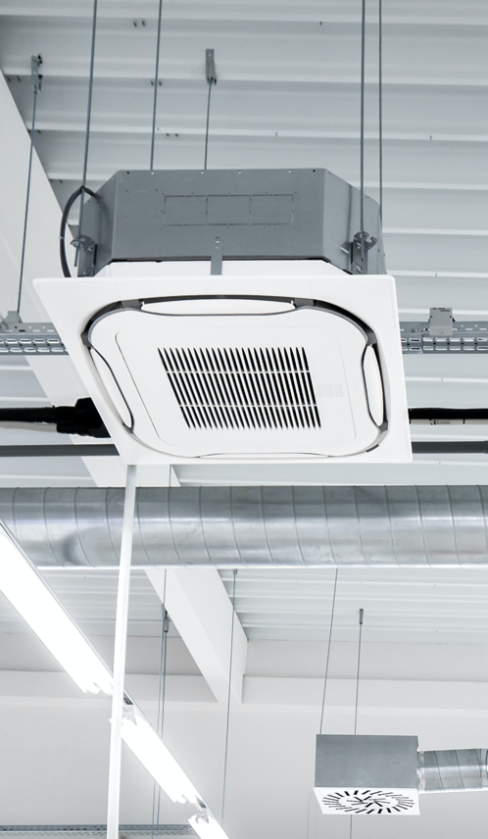
Xcel Energy: Potential Rebates
Clean Water Pumps
Compressed Air
Fan Energy Index
Multi-family Building Efficiency
Ozone Laundry Rebate
HVAC
HVAC-R Trade Partner
Lighting
Food Service Equipment
Commercial Refrigeration
Questions?
Email energyefficiency@xcelenergy.com
source: Xcel Energy website | July 2023

Slide 6
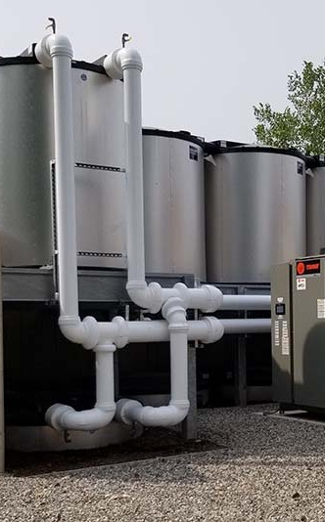
East Central Energy: Potential Rebates
Ground Source/Geothermal Heat Pumps
Premium-efficiency Motors
Commercial Lighting (lighting accounts for 40% of commercial electric consumption)
Cooling efficiency (cooling accounts for 10% of commercial electric consumption)
Ag Energy
Customizable Rebates and Incentives Possible
Questions?
Call 800.254.7944
source: East Central Energy website | July 2023

Slide 7
connect early
Once you’ve identified a project for either new construction or a retrofit, it’s important to connect with the MinnPACE team as soon as possible. This gives you the time needed to determine where C-PACE fits best within your capital stack.
MinnPACE financing is limited to 20% of the assessed or appraised value of your property, whichever is larger. Your mortgage lender will also need to sign-off on the assessment as any outstanding tax payments will take first position on the loan.

Slide 8
FUNDING SOURCES
SOURCE | FIXED RATE (7/23) | TERM | RANGE | OTHER
Local banks and credit unions | Varies by institution | up to 15 years | Most are under $1MM | 10+ lenders participated to date; opportunity for other institutions to get involved
TrillionBTU (through the Saint Paul Port Authority) | 5.50% | up to 10 years | Up to $1MM | Prevailing wages required; off-set by lower interest rate
National PACE lenders | Varies by institution | up to 20 years | Over $1MM

Slide 9
LOCAL PROJECTS
PROPERTY | CITY | AMOUNT | DETAILS
Restaurant | Saint Cloud | $72K --------------- $137K | New White Energy Star Roof – qualitied for rebates Replacing HVAC
Toppan Merrill One, LLC | Sartell | $1.7MM | Solar Project
Storage Facility | Sauk Rapids | $45K | Solar Project

Slide 10
RECENT APPLICATIONS
PROPERTY | CITY | AMOUNT | DETAILS
Multi-family Housing | Saint Paul | $123K | Retrofit Boiler, Envelope, Other Efficiencies
Distribution/Warehouse | Bloomington | $13MM | Gut/Rehab HVAC, Lighting, Solar
Mixed-Use Property | Lutsen | $236K | Gut/Rehab Heat Recovery, HVAC, Other
Food Co-op | Duluth | $2.5M | Retrofit Solar

Slide 11
solar
Don’t hit the snooze button on solar. With the Inflation Reduction Act in place, there has never been a better time to invest for less. If you have the roof space, use it to your advantage!
“The IRA is the most transformational clean energy policy in history. Companies turn to solar for many reasons: to power their operations, to meet environmental goals, or simply to save money. No matter the reason, going solar is a smart business decision.” - SEIA

Slide 12
MAXIMIZING INCENTIVES: THE INFLATION REDUCTION ACT (IRA)
Investment Tax Credit (ITC)
Accelerated Depreciation
Direct Pay
REAP + IRA
Now 30% with the opportunity for another 10% for each of the following:
Through the Modified Accelerated Recover System (MACRS), qualifying energy equipment may be fully depreciated over five years
Combined with ITC, the overall cost of solar can be reduced as much as 70%
Reduces tax liability + accelerated the ROI
Tax-exempt organizations can receive a refund from the IRS for tax credits on projects put in service (up to 1MW)
Eligible taxpayers not eligible for direct pay may sell all or a portion of the tax credits each year to another eligible taxpayer.
Available to small biz and farmers
Six quarterly competitions
Grants up to $500K for energy efficiency
Grants up to $1MM for renewable energy
Projects located in a low-income community
Projects located in communities negatively impacted by the closing of fossil fuel plans
Use of domestically-made solar panels
Consult your tax advisor to determine how they incentives may benefit your commercial property.

Slide 13
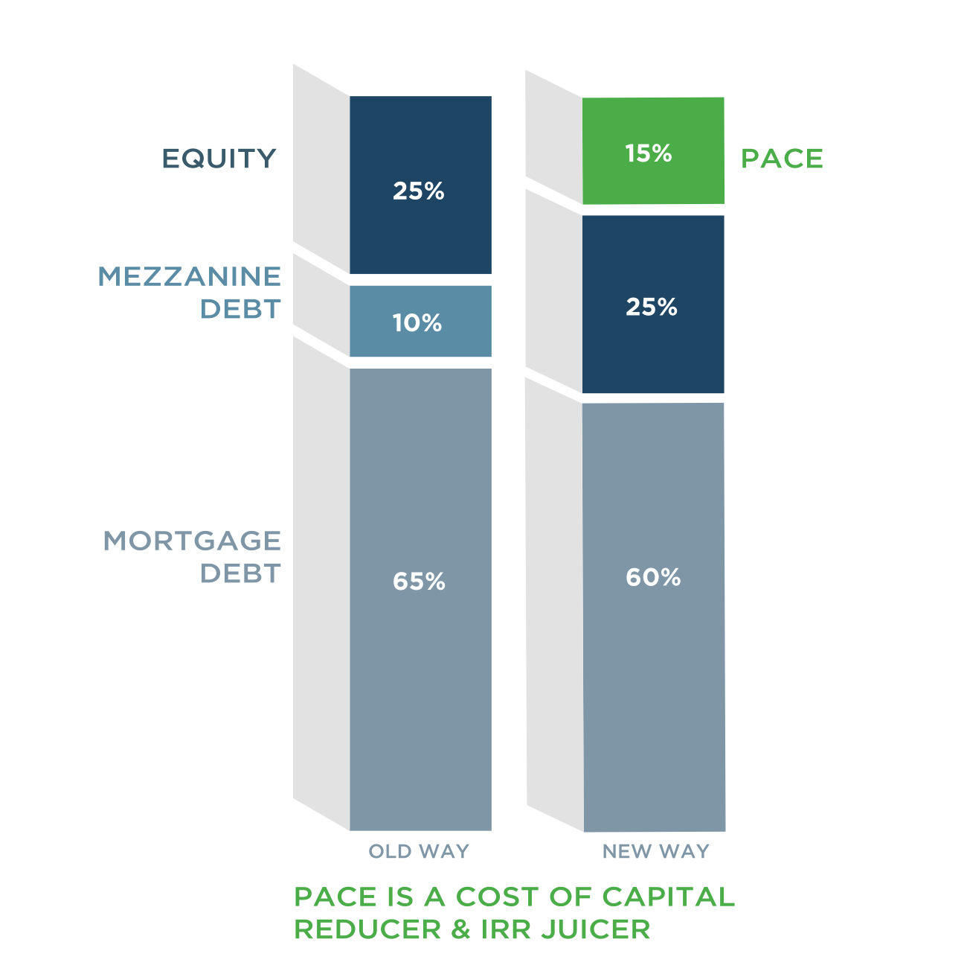
new construction
C-PACE can improve the economics of a project by replacing equity with a long-term, fixed rate finance solution.
source: PACE Loan Group

Slide 14
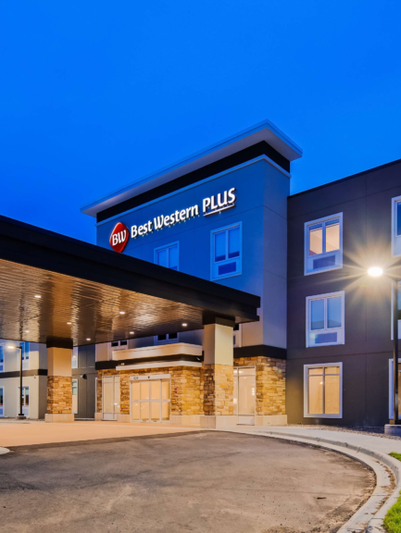
TRENDING INDUSTRIES
Farming
Hotels
Manufacturing
Senior Living Facilities

Slide 15
BENTON COUNTY OPPORTUNITIES
Lifetime Net Savings Potential for Retrofits: $17.8 million
Highest Energy Users in Benton County
Education
Food Sales
Food Service
Lodging
Nursing
Outpatient Healthcare
Refrigerated Warehouse
Retail
Source: Building Energy Market Assessment Tool from the Department of Energy. Includes 566 commercial buildings; multi-family excluded.

Slide 16
BENTON COUNTY OPPORTUNITIES
Lifetime Net Savings Potential for Retrofits: $17.8 million
#1 Non-refrigerated Warehouses
Biggest Opportunity ($8.5 million)
LED Lights (greatest potential energy savings + highest net financial gains)
Rooftop Heat Pumps
Packaged Rooftop Units
Source: Building Energy Market Assessment Tool from the Department of Energy. Includes 566 commercial buildings; multi-family excluded.

Slide 17
BENTON COUNTY OPPORTUNITIES
Lifetime Net Savings Potential for Retrofits: $17.8 million
#2 Retail Buildings
LED Lighting
Rooftop Heat Pump
Packaged Rooftop
Source: Building Energy Market Assessment Tool from the Department of Energy. Includes 566 commercial buildings; multi-family excluded.

Slide 18
BENTON COUNTY OPPORTUNITIES
Lifetime Net Savings Potential for Retrofits: $17.8 million
#3 Vintage Buildings
Average age of a commercial building in Benton County is 41 years.
Top investments nationwide include HVAC systems, Lighting, Building Envelopes, Roof Replacement, and Window Retrofits
Source: Building Energy Market Assessment Tool from the Department of Energy. Includes 566 commercial buildings; multi-family excluded.

Slide 19
BENTON COUNTY OPPORTUNITIES
Lifetime Net Savings Potential for Retrofits: $17.8 million
#4 “Honorable Mentions”
Retail
Service
Office
Source: Building Energy Market Assessment Tool from the Department of Energy. Includes 566 commercial buildings; multi-family excluded.

Slide 20
where do we go from here?
What are the energy goals in Benton County?
Are there any large projects in the works or starting soon (new construction or rehab)?
Are there vast rooftop spaces that would benefit from solar?
Are there opportunities to educate others with webinars throughout the year?
Developers, contractors
Chambers, business associations
Area farmers
Are there tools we could provide to the county/economic development team?
Are there opportunities to connect with the local media?

Slide 21
QUESTIONS?
Andrea Novak, SVP Marketing & Communications
616.219.0250 | aln@sppa.com
minnpace.com

