Slide 1
Annual Meeting
January 25, 2024

Slide 2
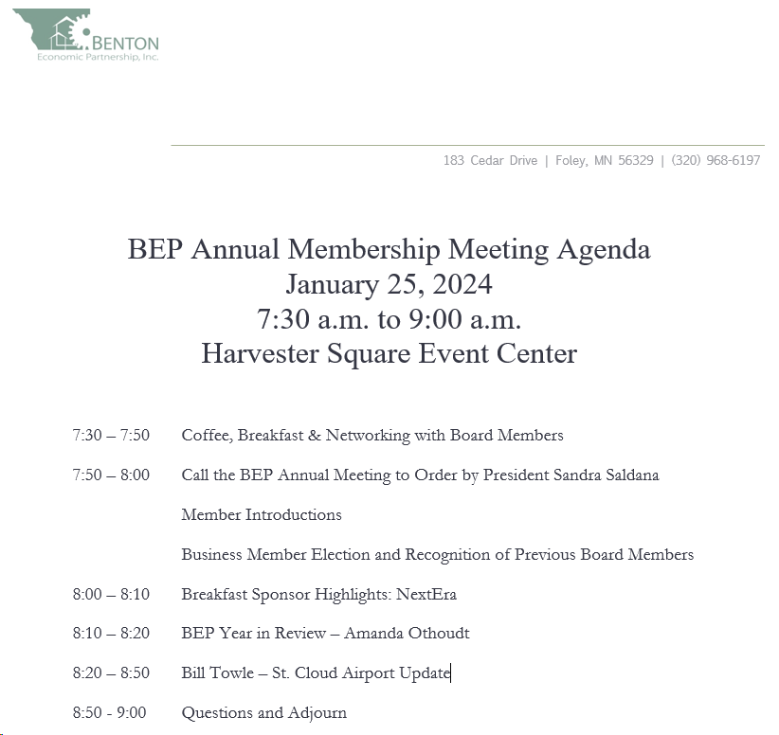

Slide 3
BEP Board Business Member Elections Board Nominations John Herges– 3 Year Term Kevin Johnson– 3 Year Term

Slide 4
Recognizing the 2023 BEP Board of Directors
Sandra Saldana, President
Kevin Johnson, Vice President
John Herges, Past President
Pat Welty, Treasurer
Jake Bauerly, Founding Member
Ed Popp, County Representative
Greg Bruestle, Township Representative
Laura Kangas, Local Business Representative
Dr. Trish Perry, Local School Representative
Todd Schultz, City Representative
Sam Lieser, Chamber Representative

Slide 5
BEP Annual Meeting Sponsor

Slide 6
BEP Year in Review

Slide 7
Increase awareness of BEP, retain, and grow BEP membership.
124 Total Members & Growing!
2023 Quarterly Meetings
City/County Update in January 2023
Educator/Workforce Panel in April 2023
MinnPACE Program in July 2023
Second Chance Workers Program in October 2023
BEP Attended the 2021 & 2022 Consultants Forum
BEP Attended the 2022, 2023 & will be attending the 2024 Site Selector Guild

Slide 8
Expand or build businesses in Benton County.
Since 2020, BEP leveraged over $2.7M in public (state and local) incentives, which resulted in over $30.1M in private capital investment.
These projects results in the retention of 441 jobs, and the creation of 71 new FT jobs for the county.
Business Retention and Expansion Program (BR&E)
17 Businesses visited in 2023
Manage the County’s Revolving Loan Fund Program
3 Loans Out
2 Loans Pending
Year End Cash Balance: $879,324

Slide 9
Facilitate Development in East St. Cloud
City of St. Cloud, GSDC and BEP partnered together to apply for the Main Street Economic Revitalization Grant Program – Received $1.5M for the Downtown St. Cloud Corridor.
Harvester Square Event Center – Received $171,643 from the Main Street Program.
Mackerel Building/Camille Apartments – Received $60,000 from the Main Street Program.
539 Properties– Received $197,000 for Construction Assistance/Franchise Fee Program.
Iron Street Distillery – Received $145,000 in County Microloan funds
Advanced Interconnect Technologies – awarded $125,000 in MIF and $341,500 in JCF for their building expansion

Slide 10
Identify and align business workforce needs with K-12 and Higher Ed educational offering
Workforce Committee Established in 2022
Participated in the EPIC Event and EPIC for Influencers
Established a partnership with Central MN Re-Entry Program (CMNRP). They received $240,000 in the form of a grant from the Initiative Foundation for housing and social assistance to grow their program. They will receive $25,000 in 2024 to develop a strategic plan and implementation strategies.
BEP Received a $10,000 grant from the Initiative Foundation to identify housing opportunities in Benton County for Second Chance Workers in partnership with the Central MN Re-Entry Program

Slide 11
Identify community development opportunities to lead in Benton County.
County Housing Study
Completed in 2023
Housing Demand in Benton County: 3,800+ units
Full Housing Study available on our website www.bentonpartnership.org
BEP to manage Benton County’s Local Housing Aid
$120,480 in Local Housing aid in 2023 and 2024 (and beyond?)
BEP to establish a county-wide rehab loan program with funds
Income Based
More details to come!

Slide 12
Identify community development opportunities to lead in Benton County.
County Broadband Initiative
Build out county with fiber to home and business
Benton Communications
$13M Investment – To be completed in 2024
Designating Region 7W as a Federal Economic District
Four county region – Benton, Stearns, Sherburne, Wright
Allows Benton County to be eligible for funding from Federal EDA.

Slide 13
BEP Annual Meeting Keynote Speaker

Slide 14
