Slide 1
St. Cloud Regional Airport
BENTON ECONOMIC PARTNERSHIP Meeting
January 25, 2024

Slide 2
Airport Authority Board
John Quade
Ryan Daniel
Brian Myres
Kevin Jonhson
Angie Olson
King Banaian
Craig Blonigen
Jami Bestgen
Marshall Grams

Slide 3
About STC
Authority Owned
1,400 acres
2 RWYs
7,500 x 150
2 Precision ILS
45,000 operations
92 based aircraft (plus 12 military helos)
Air Traffic Control Tower

Slide 4
Commercial Service
Allegiant Airlines
Phoenix/Mesa
Punta Gorda, FL

Slide 5
Charter Activity
Sun Country Charters to Laughlin, NV
Military and Sports Teams

Slide 6
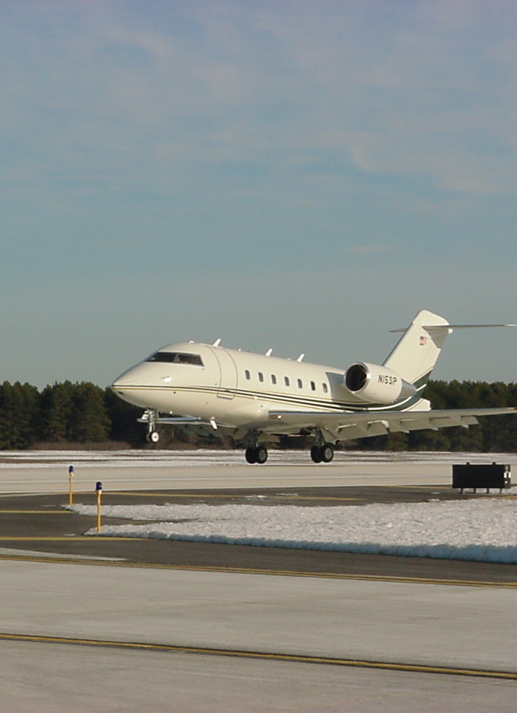
General Aviation Use
Corporate
Training
Personal
Medical
Public use
Government
Maintenance
Agricultural

Slide 7
Military (Army Aviation Support Facility)
6 Chinook Helicopters
6 Blackhawk Helicopters
Blackhawk
Chinook

Slide 8
Passengers and Operations

Slide 9
Federal Funding
How FAA is Funded
How FAA Distributes
Passengers
Cargo
Fuel
Entitlement
St Apportionment
Discretionary
PFC Authorization

Slide 10
Funding for Airports is User Fee Based
FAA Funding Sources:
State Funding Sources:
Aircraft Registration
Aviation Fuel Sales
Airline Tax
Airline Passengers
Aviation Fuel Sales
Cargo
Federal Split 90/10 State Split 70/30

Slide 11
State Funding
State Airports Fund
How it’s spent
NPIAS airports
Priority System for Projects
Aircraft Registration
Flight line prop tax
Fuel tax

Slide 12
Construction (Capital) Budget
Federal
90/10
State
70/30
Local
PFC
Sales Tax

Slide 13
Operating Budget
Operating Budget
$1,882,200
Annual Economic Impact
$44,000,000
City to continue providing $620,000 per year until 2030.
$200,000 annually in local option sales tax until 2038 for capital.

Slide 14
Major Historical Projects Since 2000 ($42M)
Runway/Taxiway Reconstruction
Air Traffic Control Tower
Equipment Building
Master Plan
Water Utilities
Terminal Expansion
Crosswind Runway Reconstruct
Main Runway Extension
Hangar Development Area
Taxiway Recontruction

Slide 15
Construction Projects
New T Hangar
New Airport Rescue and Fire Fighting (ARFF) Truck
New Air Traffic Control Tower (ATCT) Radios

Slide 16
Other Items
Strategic Plan Completed 2023
Private Hangar Development
Fixed Base Operator (FBO) Large Hangar Need
Aircraft Mechanics School

Slide 17
Instrument Landing System (ILS) Replacement Project
Glideslope Antenna
Approach Lighting System (ALS)

Slide 18
ILS Replacement Project
$6 Million to Move and Replace ILS and ALS
Removes Displaced Threshold

Slide 19
Forward Thinking
Commercial Air Service
Expand Commercial Air Service
General Aviation
Attract Additional General Aviation Activity
Sustainability
Enhance Revenues and Consider New or Unique Revenue Producing Ideas

Slide 20
Thank You
Bill towle
Executive director
William.towle@ci.stcloud.mn.us

